Slide 1

This course was developed as a part of the follwoing VLIR-UOS Cross-Cutting projects:
Statistics: 2011-2016, 2017.
Statistics: 2017.
Statistics for development : 2018-2022.

Slide 2





Basic concepts in statistical modeling using R: simple linear regression
The >eR-Biostat initative
Making R based education materials in statistics accessible for all
Developed by
Legesse Kassa Debusho (UNISA, South Africa) and Ziv Shkedy (Hasselt University)
https://erbiostat.wixsite.com/erbiostat
ER-BioStat
https://github.com/eR-Biostat
Email: erbiostat@gmail.com
@erbiostat

Slide 3
Contents
Simple linear regression:
  Introduction and model formulation.
  Fitting a simple linear regression model using the lm() function in R.
  Model diagnostic.
  Model diagnostic in R.
https://erbiostat.wixsite.com/erbiostat

Slide 4

Recommended reading
The book is available for free online:
https://www.openintro.org/book/biostat/
Chapter 6: Simple linear regression

Slide 5
Recommended reading
In this part of the course, we cover mainly Chapter 6.
The examples that are used in the slides for illustration are not the same as the examples in the book.
Use the R program to reproduce the examples.
Chapter 6: Simple linear regression

Slide 6
Part 1
Simple linear regression

Slide 7
Introduction

Slide 8
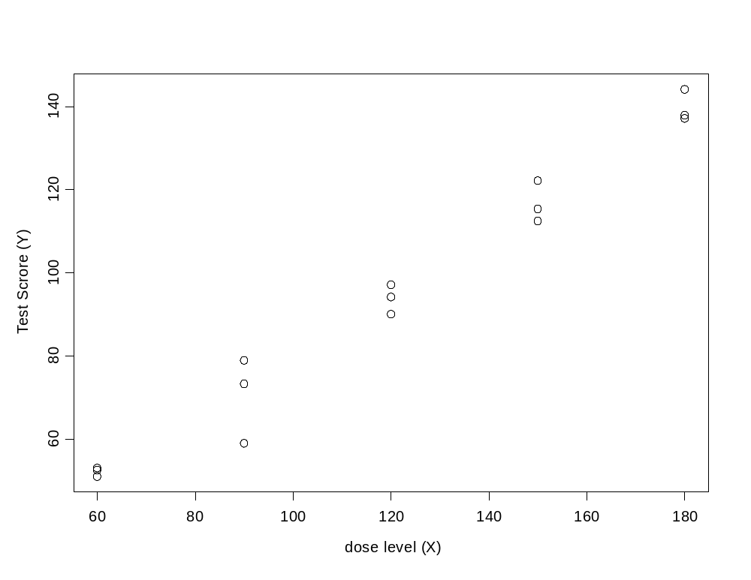
A Biopharmaceutical problem
A group of 15 rats received a dose of a drug and then had to complete a test.
It is assumed that the performance of the rat (=test score) depends on the dose level.
The data
A rat with dose=150 and test score=123.56

Slide 9
Description of the experiment
The rat receives a dose of drug
The rat starts the test
The end of the test
5 minutes
Evaluation of the rat. The higher the score the better.

Slide 10
The evaluation of the rat
The response variable:
Y_{i} is the time inside the red zone divided by the time outside the red zone (times 100).
Red light
Way out
A bath with water
A rat with dose X_{i}
Way in
The mission of the rat: swim directly to the other side (the red light)

Slide 11
Description of the experiment
Rat 1
Rat 2
Way out
A bath with water
The main assumption: the drug will reduce the time in the water of the rat.
Way in

Slide 12
The evaluation of the eat
Way out
A rat with dose X_{i}
All rats are trained (without drug) before the experiment !!!
Way in

Slide 13
The evaluation of the rat
Red light
Way out
A rat with dose X_{i}
All rats are trained (without drug) before the experiment to swim to the red light!!!
Way in

Slide 14
The scientific question
Does the performance of the rat depend on the dose level ?
A good drug is expected to improve the rats’ performance (swim directly to the red light)
The scientists expect that: the higher the dose the better the performance

Slide 15
The data
Upward trend: in general, test score increases with dose level

Slide 16
Regression terminology
The test score (Y_{i}) is the dependent variable. It depends on the dose level (X_{i}).
The dose level is called the independent variable or the predictor.
The observation unit:
(X_{i},Y_{i}), i=1,2,…,n.
(X₁₁,Y₁₁)

Slide 17
Data structure
The dose response data:
2 variables.
15 subjects.
(X₁,Y₁)
(X₂,Y₂)
. .
. .
(X_{i},Y_{i})
. .
. .
(X_{n},Y_{n})
60 56.07362
60 49.45516
60 56.07840
90 74.18539
90 73.13873
90 77.35170
120 95.37789
120 93.03198
120 92.46663
150 117.61100
150 123.56117
150 119.12260
180 130.81847
180 137.31600
180 139.09742
Dependent variable y_{i}
(X₁₁,Y₁₁)
Observation 11
Dose level x_{i}
Dose level x_{i}
Test score y_{i}

Slide 18
What is a Simple Linear Regression model ?
A regression model is a statistical model which aims to describe the relationship between a predictor (the dose level) and a dependent variable (test score) with a straight line.
Y
X

Slide 19
Properties of the simple linear regression model : trends
y
y
y
X
X
X
Upward trend
Downward trend
Y does not depend on X
=no trend

Slide 20
Parameters of the simple linear regression model : slope
y
X
The slope is the change in the mean of Y for a unit change in X.
y
X

Slide 21
Parameters of the simple linear regression model : intercept
y
y
y
X
0
X
X
The intercept is the height of the regression line when X=0.
y
0
X

Slide 22
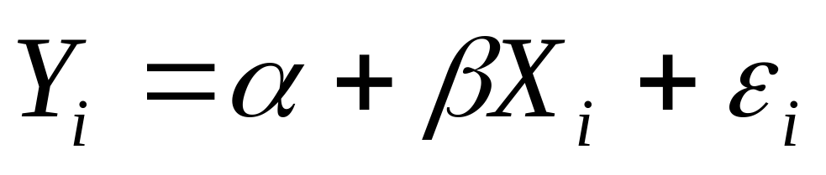
A Simple Linear Regression model: model formulation
We assume that the relationship between the predictor
and the response can be described with the model:
Dependent variable Y_{i}
Predictor X_{i}
observed
Two parameters: intercept and slope
Random error
unobserved

Slide 23
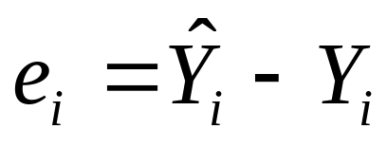
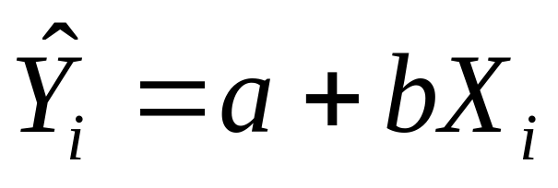
Estimation (I)
We need to estimate the unobserved parameters of the model:
The estimator for the random error:
predicted value for the test score
(the estimator for the test score)
a and b are the estimators for alpha and beta
e_{i} (the residual) is the estimator for the random error

Slide 24
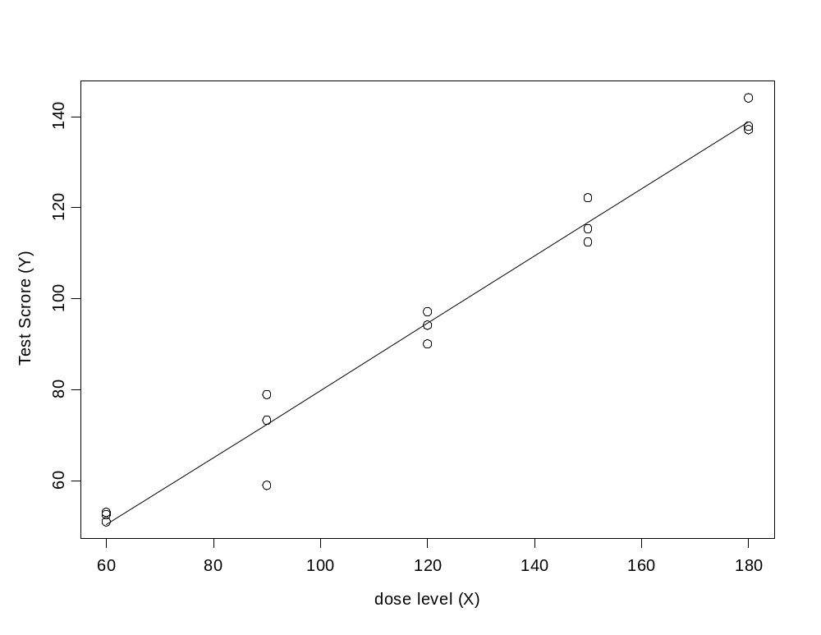
Regression model & the data
a: the estimate for alpha
b: the estimate for beta
The estimated (fitted) model
The regression line
Y_{i}=12.06+0.69 X_{i}
The model

Slide 25
How to estimate the intercept and the slope ?
Y_{i}=12.06+0.69 X_{i}

Slide 26
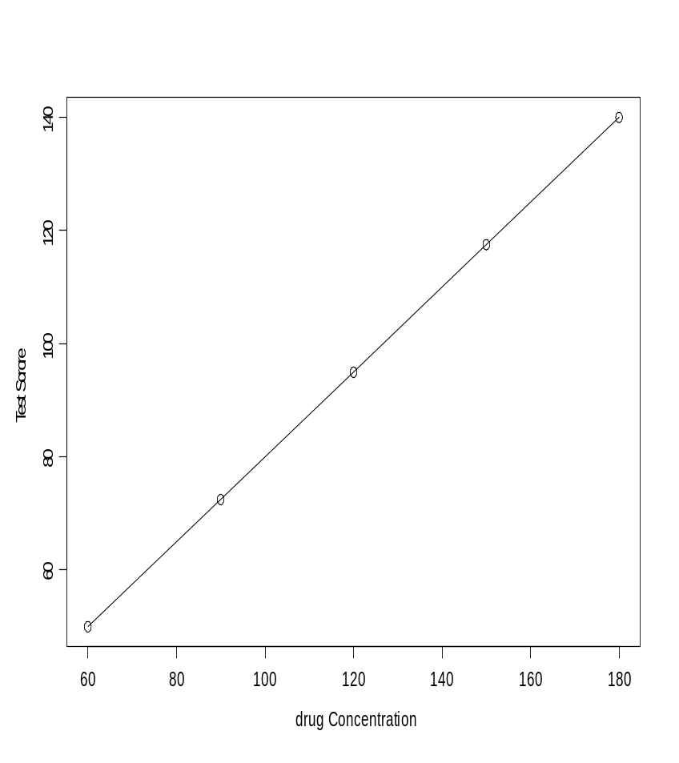
Regression model & the data
A EXAMPLE OF PERFECT FIT…
….BUT WE DO NOT EXPECT A PERFECT FIT…

Slide 27
The residuals
The difference between the observed response and the predicted response.
Y_{i}
X_{i}
e₁₁=(a+bX₁₁)-Y₁₁
residual
Y₄
e_{i}
X₄
X_{i}

Slide 28
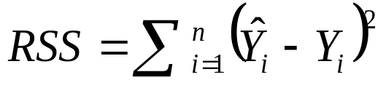
Estimation (II): The Least Squares Criterion
How to estimate the intercept and slope?
We want that the fitted model (the line which describes the relationship between Y and X) will be “close” to the data.
The residual sum of squares = sum (residual)².
The least squares criterion: choose intercept and slope which minimize the residual sum of squares

Slide 29
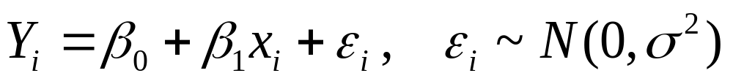

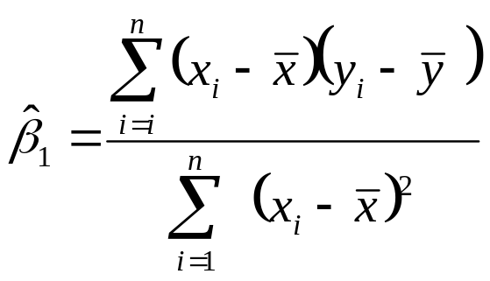

Parameter estimates
Unknown parameters in the model
OLS estimates for β₀ and β₁ (for a and b)

Slide 30
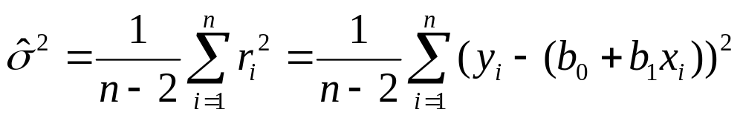

Parameter estimate for the variance

Slide 31
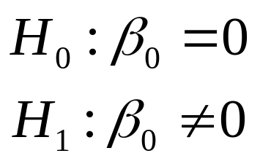
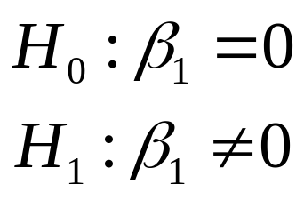
Inference
Intercept equals to zero
Slope equals to zero
y
y
X
X

Slide 32
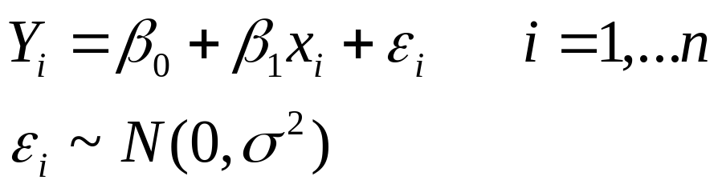
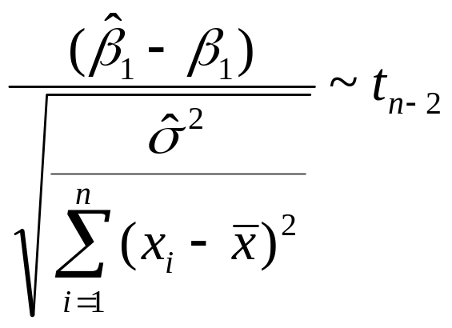
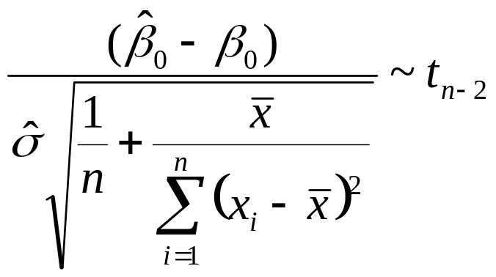
Test statistics
For the simple linear regression model:
Test statistic for β₁
Test statistic for β₀

Slide 33
The intercept and the slope:
Interpretation

Slide 34
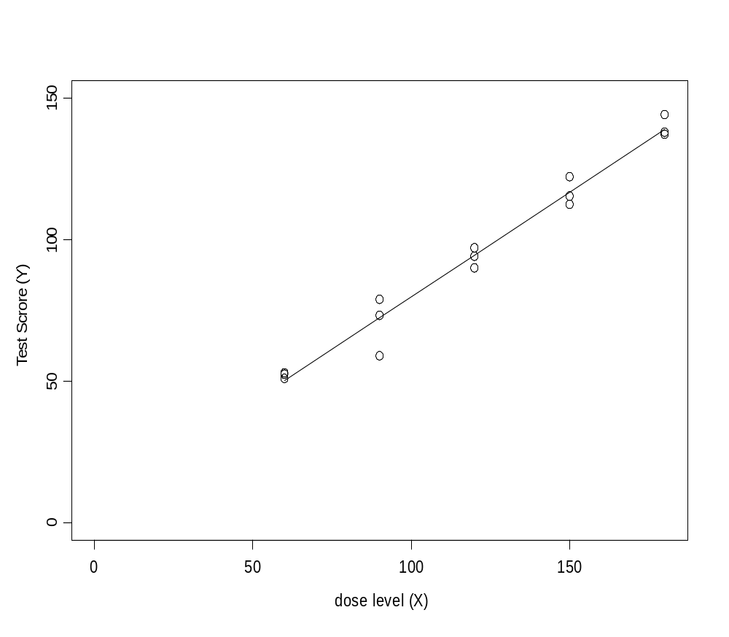
Interpretation: the Intercept
The intercept is the predicted test score for dose level zero:
For X_{i}=0 we have:
Predicted test score=12.09+0.
Intercept

Slide 35
Interpretation: the slope
Suppose that we have two rats: the first received a dose of 100 and the second dose of 101.
WHAT IS THE DIFFERENCE BETWEEN THE PREDICTED VALUES OF THE TWO RATS ?
Dose level 100:
Dose level 101:
Predicted value=12.09+0.69*100
Predicted value=12.09+0.69*101
(12.09+0.69*101)-(12.09+0.69*100)=0.69
The difference is equal to 0.69 which is the value of the slope
The slope is the change in the (expected) response level for a unit change in the predictor

Slide 36
How can we estimate a simple regression model in practice?

Slide 37
Part 2
Fitting a simple linear regression in R using the lm() function

Slide 38
The Data in R
Dose <- c(60,60,60,90,90,90, 120,120,120,150,150,150,180,180,180)
Score <- (56.07362,49.45516,56.07840,74.18539,73.13873,77.35170,95.37789,93.03198,
92.46663,117.61100,123.56117,119.12260,130.81847,137.31600,139.09742)
dose.data <- cbind(Dose, Score)
print(dose.data)
Dose Score
[1,] 60 56.07362
[2,] 60 49.45516
[3,] 60 56.07840
[4,] 90 74.18539
[5,] 90 73.13873
[6,] 90 77.35170
[7,] 120 95.37789
[8,] 120 93.03198
[9,] 120 92.46663
[10,] 150 117.61100
[11,] 150 123.56117
[12,] 150 119.12260
[13,] 180 130.81847
[14,] 180 137.31600
[15,] 180 139.09742
Name of the data
Dependent
variable
Predictor

Slide 39
The function lm( ) in R
Simple linear regression model can be fitted in R using the function lm( ).
The model statement:
fit.dose <- lm(Score ~ Dose,data = dose.data)
Example of R script for function lm( )
Score ~ Dose
Dependent variable
Predictor
y ~ x

Slide 40
Fitting the model in R
Dose <- c(60,60,60,90,90,90, 120,120,120,150,150,150,180,180,180)
Score <- (56.07362,49.45516,56.07840,74.18539,73.13873,77.35170,95.37789,93.03198,
92.46663,117.61100,123.56117,119.12260,130.81847,137.31600,139.09742)
dose.data <- cbind(Dose, Score)
print(dose.data)
Dose Score
[1,] 60 56.07362
[2,] 60 49.45516
[3,] 60 56.07840
[4,] 90 74.18539
[5,] 90 73.13873
[6,] 90 77.35170
[7,] 120 95.37789
[8,] 120 93.03198
[9,] 120 92.46663
[10,] 150 117.61100
[11,] 150 123.56117
[12,] 150 119.12260
[13,] 180 130.81847
[14,] 180 137.31600
[15,] 180 139.09742
> fit.dose <- lm(Score ~ Dose)
> summary(fit.dose)
Dependent
variable
Predictor
lm(y ~ x)

Slide 41
Output
ESTIMATION
INFERENCE
Coefficients:
Estimate Std. Error t value Pr(>|t|)
(Intercept) 12.06329 0.71389 4.445 0.000661 ***
Dose 0.69652 0.02132 32.666 7.28e-14 ***
---
Signif. codes: 0 ‘***’ 0.001 ‘**’ 0.01 ‘*’ 0.05 ‘.’ 0.1 ‘ ’ 1
Residual standard error: 3.504 on 13 degrees of freedom
Multiple R-squared: 0.988, Adjusted R-squared: 0.987
F-statistic: 1067 on 1 and 13 DF, p-value: 7.279e-14
The slope: how much the response change for a unit change in the predictor
The intercept: what is the test score for dose=0

Slide 42
Summary

Slide 43



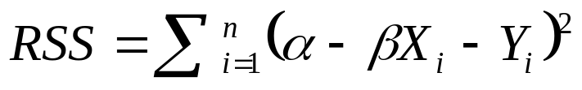
Technical details (Estimation)
A simple linear regression model has the form:
(β₀) and (β₁) are the parameters in the model and is the random error.
We can estimate and by minimizing the residual sum of squares

Slide 44
Technical details (Estimation)
The estimated model
The residual

Slide 45




Technical Details (Estimation)
We assume that the relationship between Y_{i} and X_{i} can be described with a statistical model
We assume that the random error is normally distributed.
The mean of is equal to zero
The conditional mean of Y_{i} (given the value of X_{i})
The estimator for the conditional mean of Y_{i} (the fitted model=the regression line)
The residual: the estimator for
Least square criterion: choose a and b that minimize the residuals sum of squares

Slide 46
Part 3
Model diagnostic

Slide 47

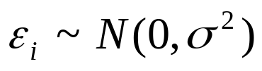
Simple regression model: assumptions
We consider the following linear regression model
The random error is assumed to be normal distributed:
We also assume that the variance is constant, i.e., ε₁,ε₂,....,ε_{n} are outcome of a normal distribution with mean zero and equal variances.

Slide 48
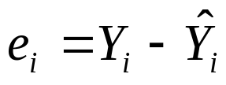
How to check the model assumptions? (1)
The random error, ε_{i}, is unknown but we can estimate ε_{i} with the residuals
The residuals can be used in order to check the model asaumptions.
We focus on:
1) the distribution of e_{i}
2) the variability of e_{i}
Observed
Predicted

Slide 49
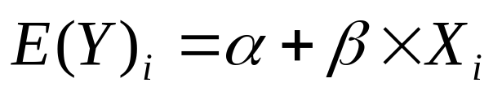
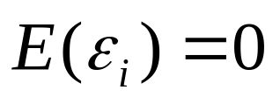
How to check the model assumptions? (2)
We assume that the mean of Y_{i} is linear with respect to X:
This is true only if
The residuals can be used in order to check the linearity assumption .
The residuals in this plot should distribute around zero and do not show any systematic pattern.
residuals
0
predictor

Slide 50
Assumption 1: The distribution of e_{i}
The distribution of e_{i} is expected to be normal with mean zero and variance σ².
qq-normal plot (or normal probability plot) is a graphical tool that can be used in order to asses the normality assumption.
If the normalty assumption holds we expect qq-normal plot will be a srtight line.

Slide 51
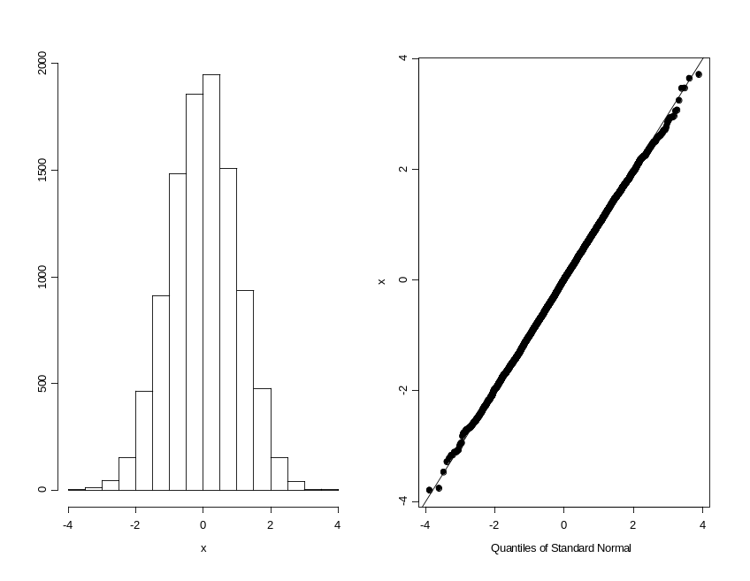
An example of qq-normal plot form N(0,1)
Sample of 10000 observations from N(0,1)
The qqnormal plot is a stright line.
If the random error ε_{i} is normal distributed, the qqnormal plot of the residuals should be a stright line.

Slide 52
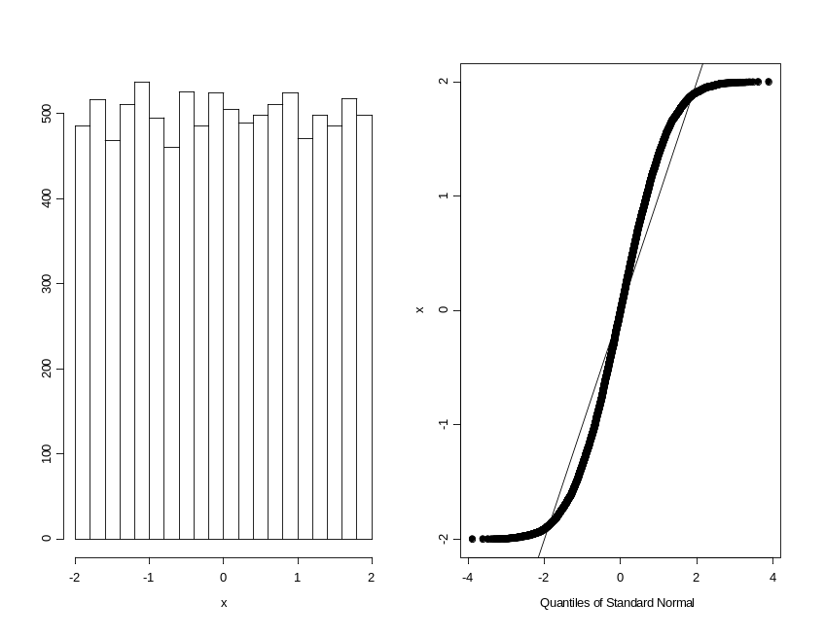
An example of qq-normal plot of a heavy tail distribution
Sample of 10000 observations from
U(-2,2).
S shape of the qqnormal plot.
This is an example of a symatric distribution with more observations (relativly to the normal distribution) at the tails.

Slide 53
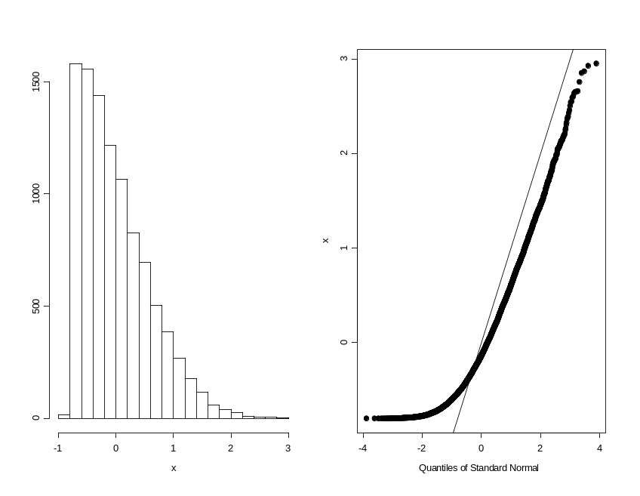
An example of qq-normal plot of a skwed distribution
Sample of 10000 observations from a skewed distribution.
The distribution is skewed to the right and the points in the qqplot are not follow the stright line.

Slide 54
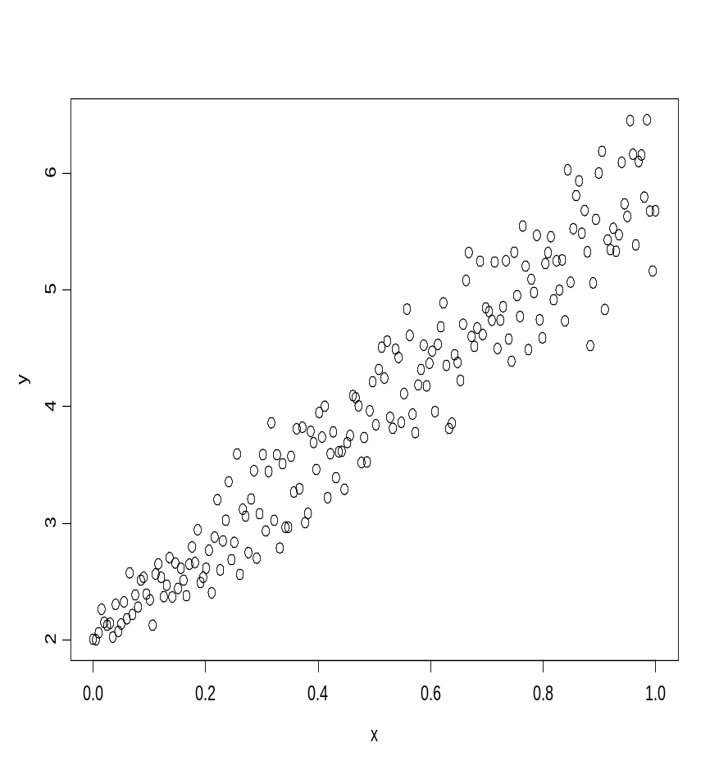
Assumption 2: Constant variance
This is an example of a dataset in which the variance is not constant.
The variance increases when the value of X increases.
However, there is a linear relatioship between the predictor and the response.

Slide 55
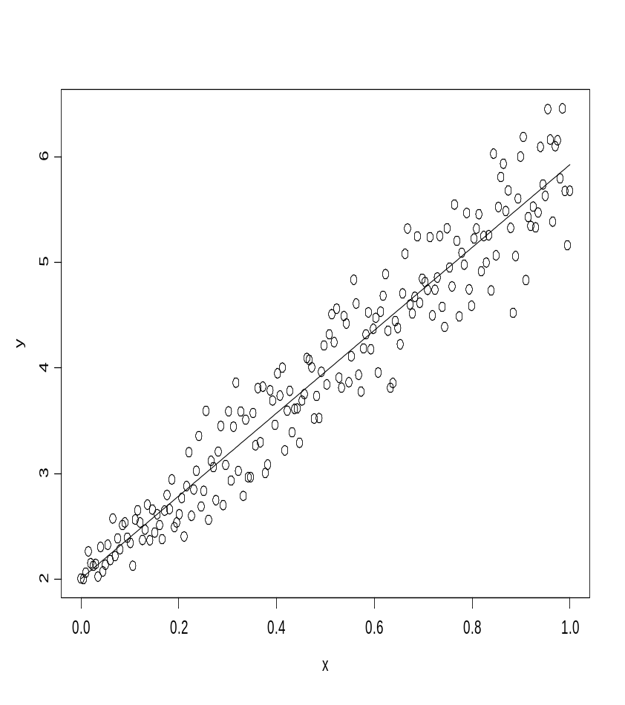
The data and the resrssion line
The model seems to fit the data well, it captures the structure of the mean.

Slide 56
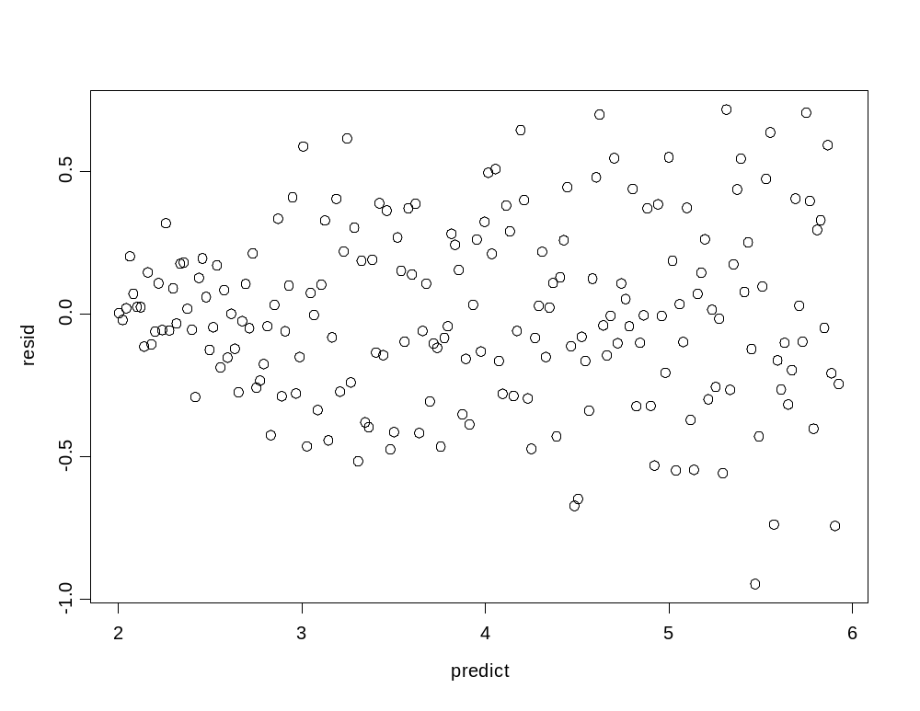
Residuals plot: residuals versus the predicted values
A clear pattern.
As the predicted values increase the variability among the residuals increase (a “megaphone” shape).

Slide 57
Assumption 3: Linearity
The data
e versus x
y
e
Example of systematic pattern in the residual plot.
0
X
X
The scatterplot of the data reveals that the association between the response and the predictor is not linear.
The residuals plot (in the right) reveals a clear pattern among the residuals which depends on the value of X.

Slide 58
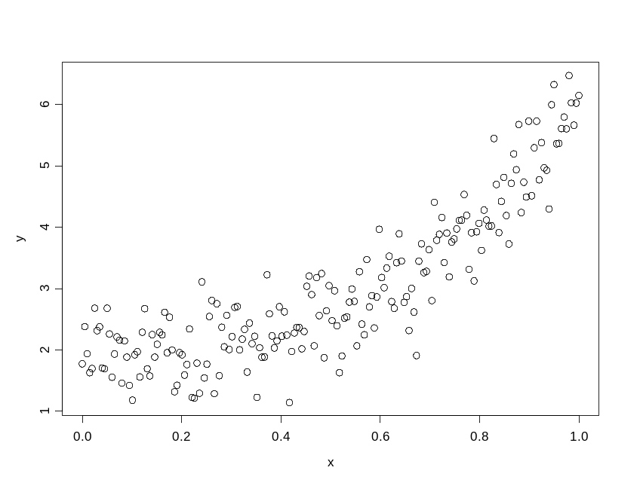
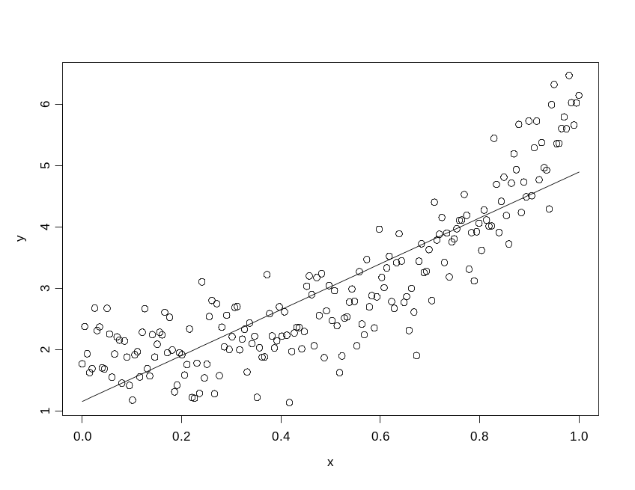
Systematic patterns
data
data and fitted model
The model underestimates the value of Y when the value of X is relatively small or large.

Slide 59
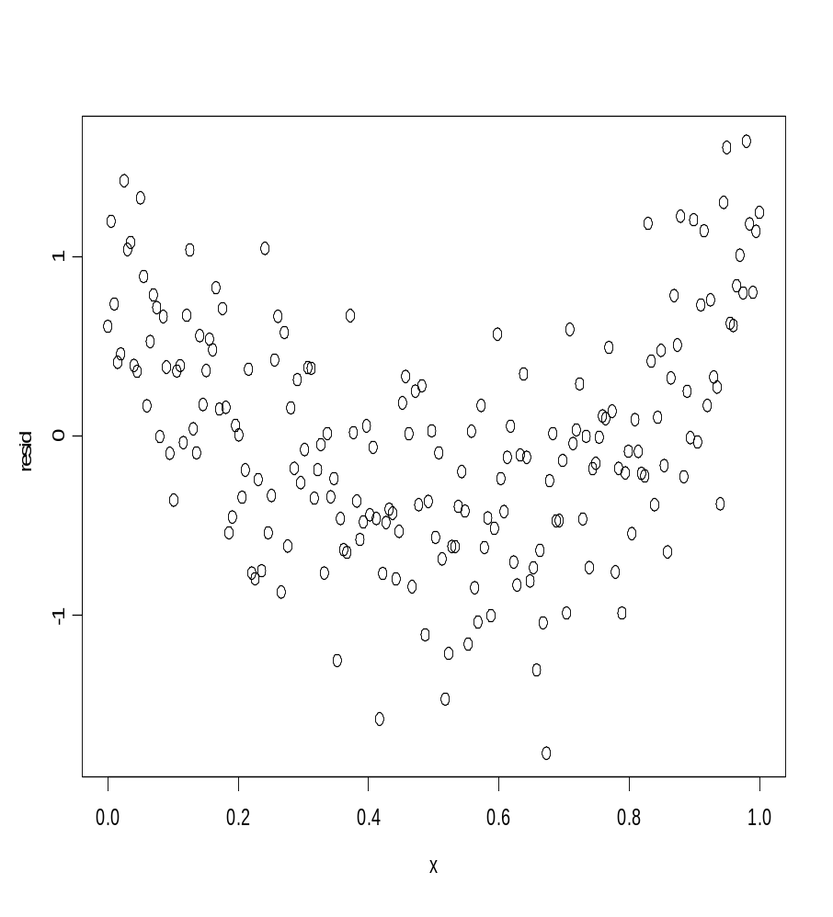
Linearity: residuals plot
Clear systematic pattern among the residuals.
The residuals are positive for small and large value of X and negative in the middle.
This means that there is structure in the data that the linear regression model did not capture.

Slide 60
Bottom line about model diagnostic
We let the residuals to tell us the story.
Departure from model assumptions (constant variance, normality and linearity) can be investigated using qq-plot and residuals plots.

Slide 61
Part 4
Model diagnostic using R

Slide 62
Fitting the model in R
Dose <- c(60,60,60,90,90,90, 120,120,120,150,150,150,180,180,180)
Score <- (56.07362,49.45516,56.07840,74.18539,73.13873,77.35170,95.37789,93.03198,
92.46663,117.61100,123.56117,119.12260,130.81847,137.31600,139.09742)
dose.data <- cbind(Dose, Score)
print(dose.data)
Dose Score
[1,] 60 56.07362
[2,] 60 49.45516
[3,] 60 56.07840
[4,] 90 74.18539
[5,] 90 73.13873
[6,] 90 77.35170
[7,] 120 95.37789
[8,] 120 93.03198
[9,] 120 92.46663
[10,] 150 117.61100
[11,] 150 123.56117
[12,] 150 119.12260
[13,] 180 130.81847
[14,] 180 137.31600
[15,] 180 139.09742
> fit.dose <- lm(Score ~ Dose)

Slide 63
The output
>summary(fit.dose)
Call:
lm(formula = Test_score ~ Dose_level, data = dose)
Residuals:
Min 1Q Median 3Q Max
-6.619 -2.113 -0.121 2.221 7.020
Coefficients:
Estimate Std. Error t value Pr(>|t|)
(Intercept) 12.06329 2.71389 4.445 0.000661 ***
Dose_level 0.69652 0.02132 32.666 7.28e-14 ***
---
Signif. codes: 0 ‘***’ 0.001 ‘**’ 0.01 ‘*’ 0.05 ‘.’ 0.1 ‘ ’ 1
Residual standard error: 3.504 on 13 degrees of freedom
Multiple R-squared: 0.988, Adjusted R-squared: 0.987
F-statistic: 1067 on 1 and 13 DF, p-value: 7.279e-14
INFERENCE
ESTIMATION

Slide 64
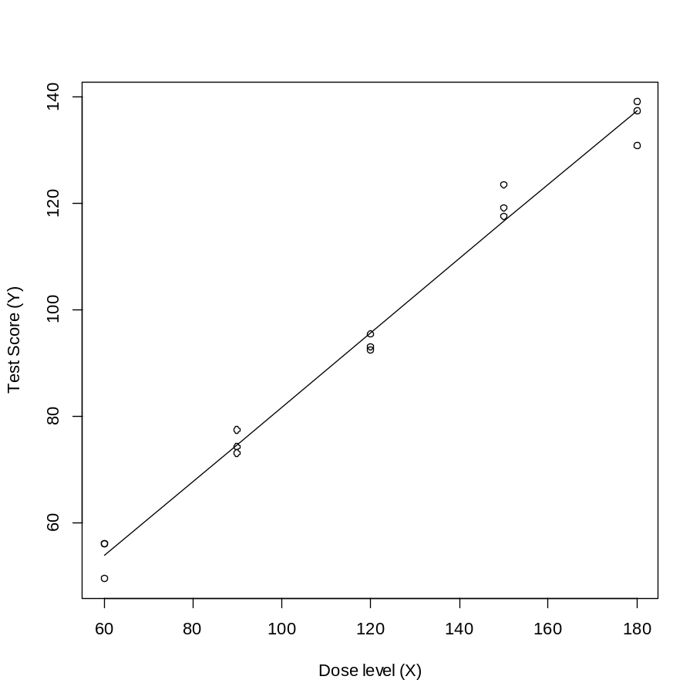
Data and predicted model
>plot(Dose,Score,
ylab = "TestScore (Y)",
xlab = "Doselevel (X)")
>x <- Dose
>y <- fit.dose$fit
>lines(x,y)

Slide 65
The output
ANOVA Table:
> aov(fit.dose)
Call:
aov(formula = fit.dose)
Terms:
Dose_level Residuals
Sum of Squares 13098.798 159.579
Deg. of Freedom 1 13
Residual standard error: 3.503618
Estimated effects may be unbalanced
Regression Sum of Squares
RSS=Residual Sum Squares

Slide 66
Graphical output
> par(mfrow=c(2,2))
> plot(fit.dose$fit,xlab="Observed",
ylab="Predicted", main = "Observed versus,
predicted values")
> abline(0,1)
> hist(fit.dose$resid,col=0,main="Histogram for
+ residuals")
> qqnorm(fit.dose$resid)
This statemnt produces the plot of the observed versus the predicted values (to check if the variance is constant)
This statemnt produces the Histogram of residuals (to check normality)
This statemnt produces the qqnormal plot (to check normality)

Slide 67
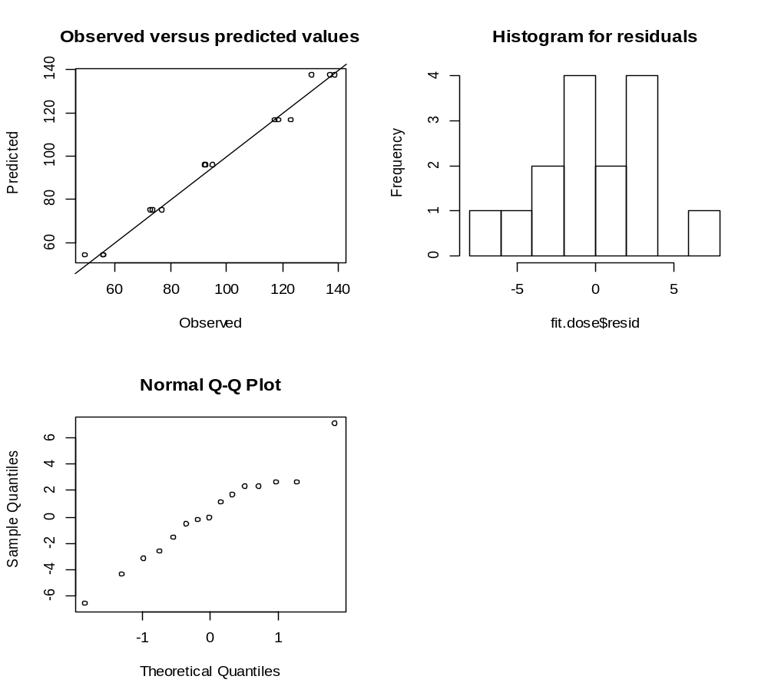
Graphical output

Slide 68
Diagnostic plots
> par(mfrow = c(2,2))
> plot(fit.dose)
This statement produces the following figures:
A plot of the residuals versus the predicted values (to check if the variance is constant).
A qqnormal plot (to check normality).
A scale-location plot (to check if the variance is constant),
A plot of residuals versus leverage (to check if there are influential observations).

Slide 69
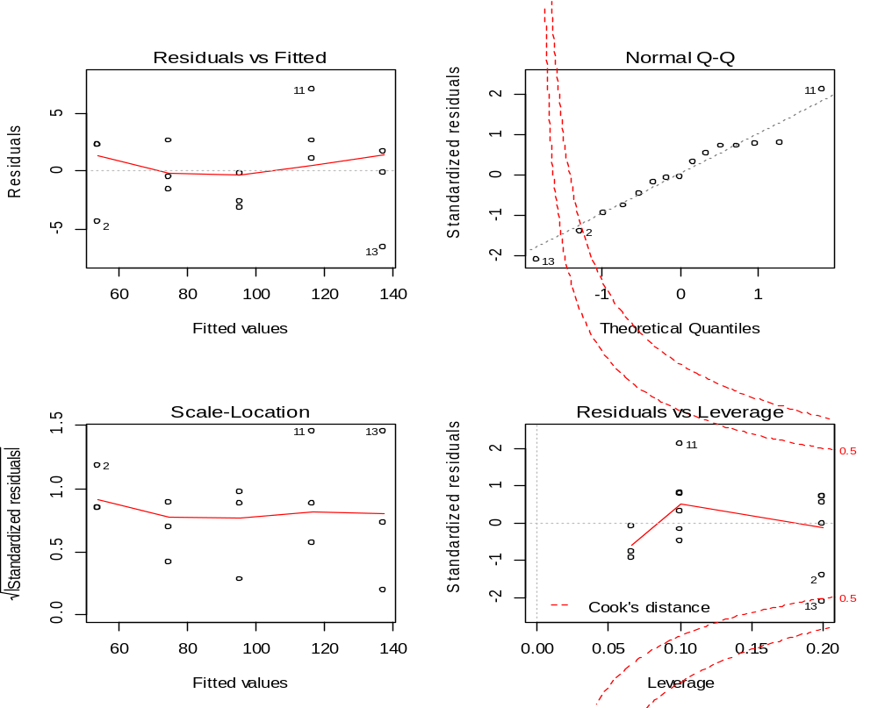
Diagnostic plots

Slide 70
Residual analyses
## Normality test ##
> shapiro.test(residuals(fit.dose))
##Constant variance test ##
> library(lmtest)
> bptest(fit.dose)
#Testing the Independence Assumption #
library(lmtest)
dwtest(fit.dose, alternative =
+ "two.sided")
Shapiro-Wilk normality test
data: residuals(fit.dose)
W = 0.9723, p-value = 0.8907
studentized Breusch-Pagan test
data: fit.dose
BP = 1.0129, df = 1, p-value = 0.3142
Durbin-Watson test
data: fit.dose
DW = 2.0775, p-value = 0.8863
alternative hypothesis: true autocorrelation is not 0

Slide 71
Part 5
Four examples for model diagnostic

Slide 72
Four examples
Example 1: all model asgsumptions hold.
Example 2: the variance is not constant.
Example 3: structure in the residuals.
Example 4: the distribution of the residuals is not a Normal distribution.

Slide 73
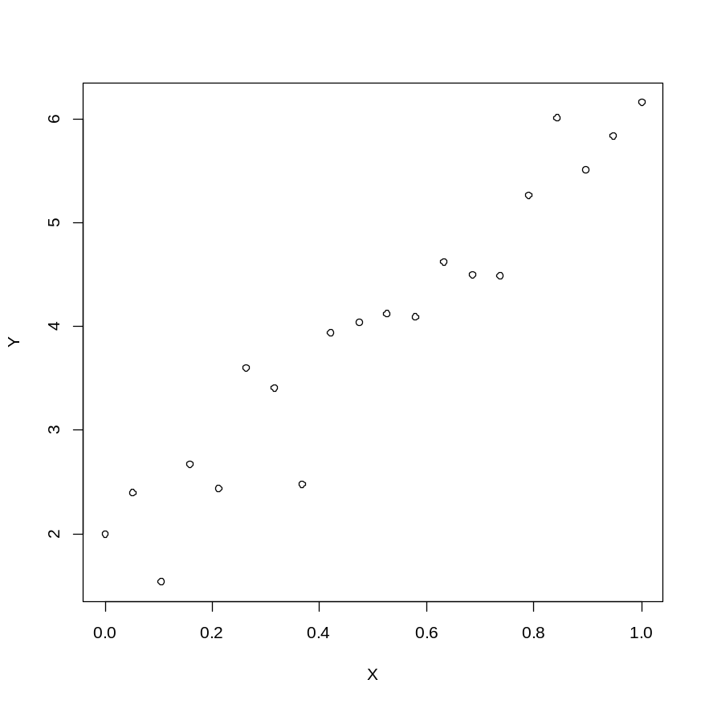
Example 1: the data
The sample size is equal to 20.
The observation unit (x_{i},y_{i}), i=1,...,20.
The relatioship between X and Y seems to be linear.
Example 1
External data: example1.txt

Slide 74
Formulation of the model
We consider a linear regression model of the form
It is further assumed that the random error is normal distributed with mean 0 and constant variance σ².
The model in R:
fit.example1 <- lm(y ~ x, data = example1)
summary(fit.example1)
aov(fit.example1)

Slide 75
ANOVA table and parameter estimates
Call:
aov(formula = fit.example1)
Terms:
x Residuals
Sum of Squares 33.38747 2.99696
Deg. of Freedom 1 18
Residual standard error: 0.4080414
Estimated effects may be unbalanced

Slide 76
ANOVA table and parameter estimates
Call:
lm(formula = y ~ x, data = example1)
Residuals:
Min 1Q Median 3Q Max
-0.91702 -0.21027 0.07406 0.20531 0.65608
Coefficients:
Estimate Std. Error t value Pr(>|t|)
(Intercept) 1.8260 0.1759 10.38 4.99e-09 ***
x 4.2582 0.3007 14.16 3.36e-11 ***
---
Signif. codes: 0 ‘***’ 0.001 ‘**’ 0.01 ‘*’ 0.05 ‘.’ 0.1 ‘ ’ 1
Residual standard error: 0.408 on 18 degrees of freedom
Multiple R-squared: 0.9176, Adjusted R-squared: 0.9131
F-statistic: 200.5 on 1 and 18 DF, p-value: 3.364e-11

Slide 77
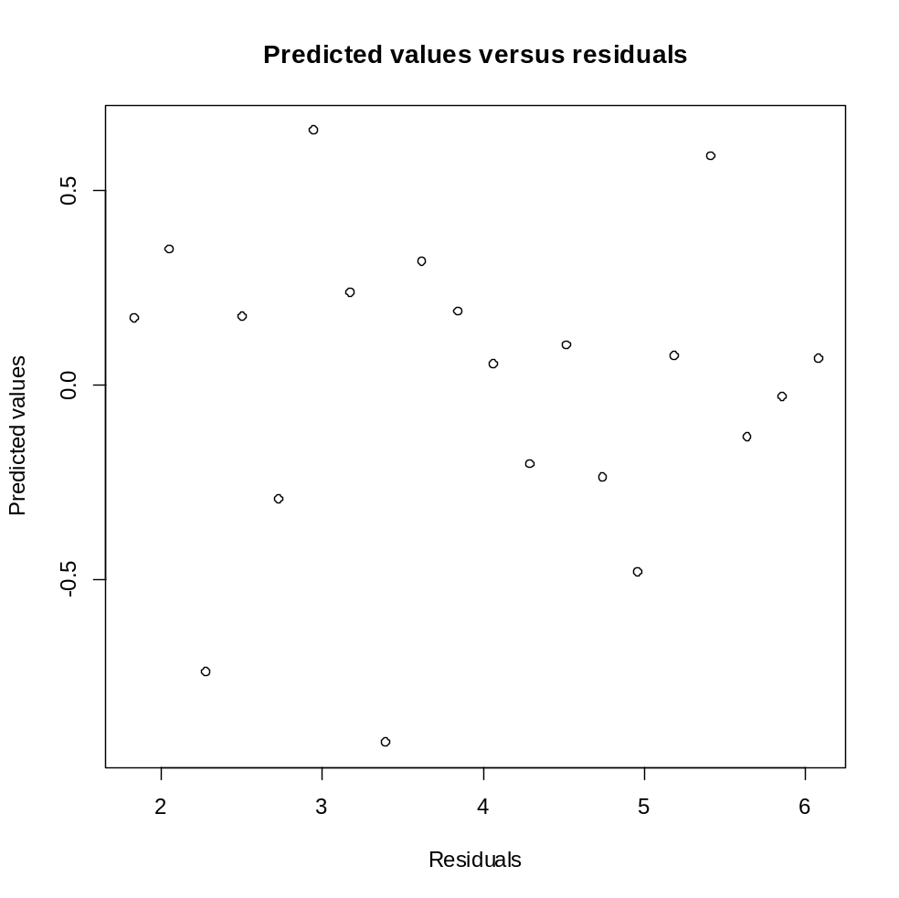
Constant variance: residuals versus predicted values
We focus in this plot on the variabilty, if it constant we do not expect to patterns in this plot.

Slide 78
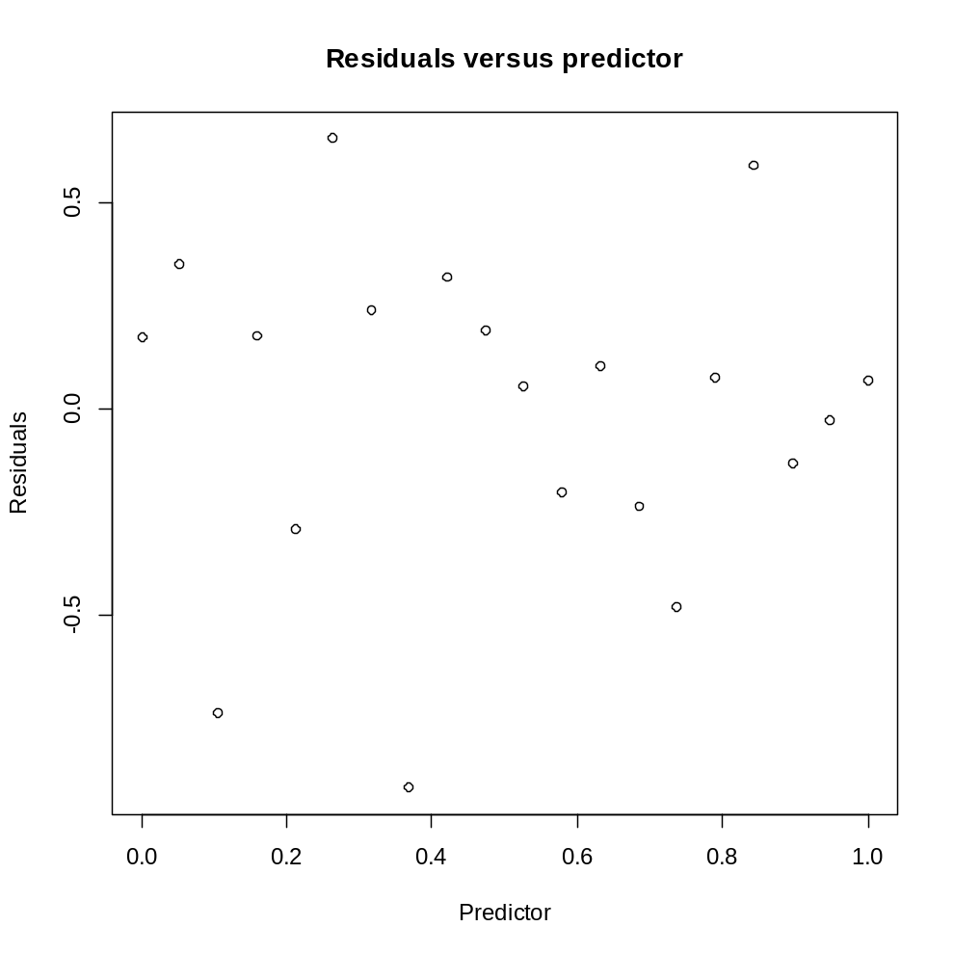
Linearity: residuals versus the predictor
If the linear model is a “good model” (this means that the assumption that the mean of Y is linear with respect to X) we do not expect to patterns in this plot.

Slide 79
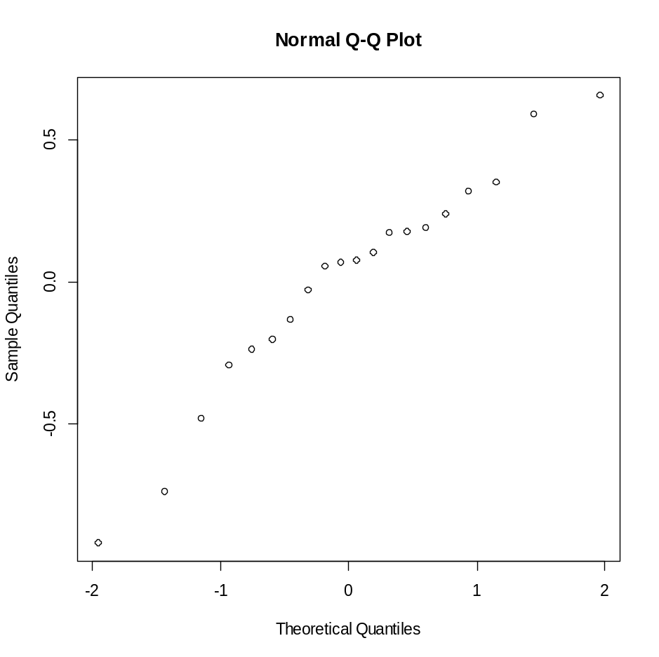
Normality: qqpolt for the residuals
If the random error is normal distributed the points in the qqnormal plot should follow a stright line pattern.

Slide 80
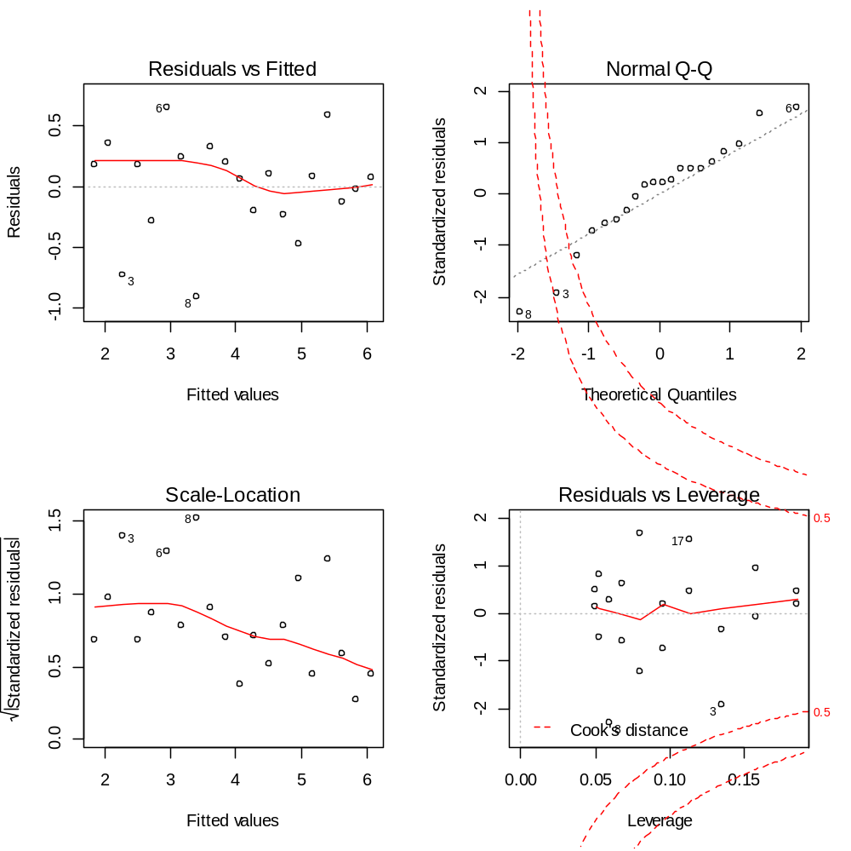
Diagnostic plots

Slide 81
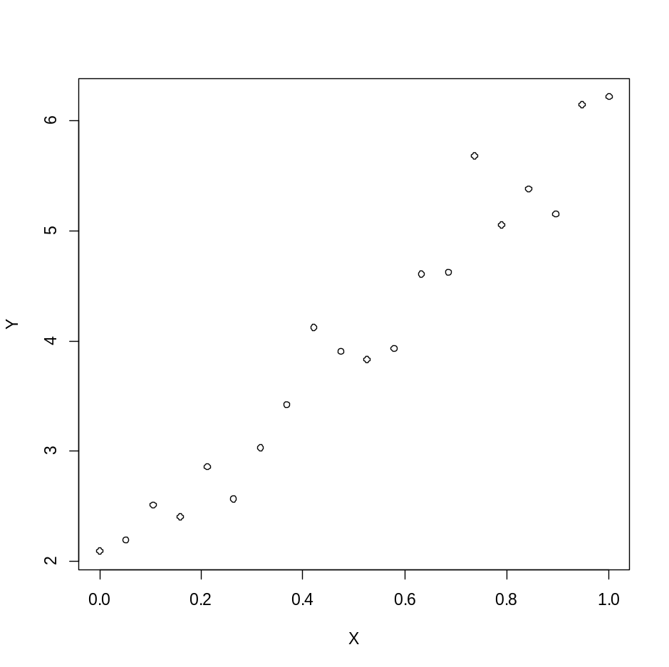
Example 2: the data
Sample size is 20.
The relatioship seems to be linear. So the regression model should fit the data.
Model in R:
#### Scatter plot of the data ####
plot(y ~ x, data = example2, ylab = "Y", xlab = "X")
#### Fitting the model ####
fit.example2 <- lm(y ~ x, data = example2)
summary(fit.example2)
aov(fit.example2)
Example 2
External data: example2.txt

Slide 82
ANOVA table and parameter estimates
> aov(fit.example2)
Call:
aov(formula = fit.example2)
Terms:
x Residuals
Sum of Squares 32.28117 1.64056
Deg. of Freedom 1 18
Residual standard error: 0.3018981
Estimated effects may be unbalanced

Slide 83
ANOVA table and parameter estimates
> summary(fit.example2)
Call:
lm(formula = y ~ x, data = example2)
Residuals:
Min 1Q Median 3Q Max
-0.48422 -0.16228 0.00692 0.14724 0.70333
Coefficients:
Estimate Std. Error t value Pr(>|t|)
(Intercept) 1.8938 0.1301 14.55 2.13e-11 ***
x 4.1870 0.2225 18.82 2.75e-13 ***
---
Signif. codes: 0 ‘***’ 0.001 ‘**’ 0.01 ‘*’ 0.05 ‘.’ 0.1 ‘ ’ 1
Residual standard error: 0.3019 on 18 degrees of freedom
Multiple R-squared: 0.9516, Adjusted R-squared: 0.9489
F-statistic: 354.2 on 1 and 18 DF, p-value: 2.745e-13

Slide 84
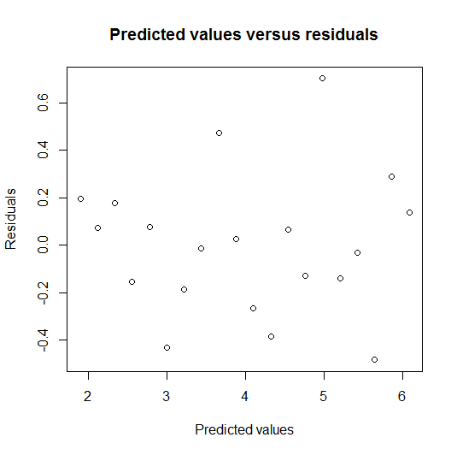
Constant variability
A “megaphon” shape.
The variability is not constant.
The variability increase as the predicted values increase.

Slide 85
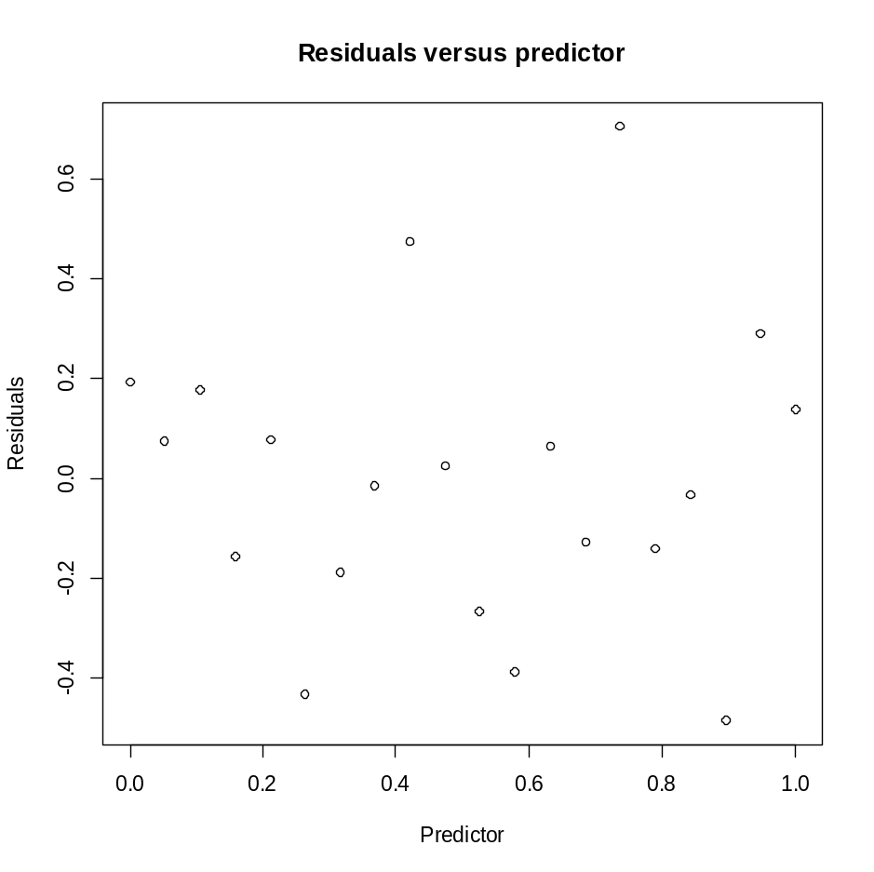
Linearity and constant variability: residuals versus the predictor
Residuals distributed around zero.
This means that the linear regression model captures the main pattern in the data.
BUT it is clear that the variability is not constant.

Slide 86
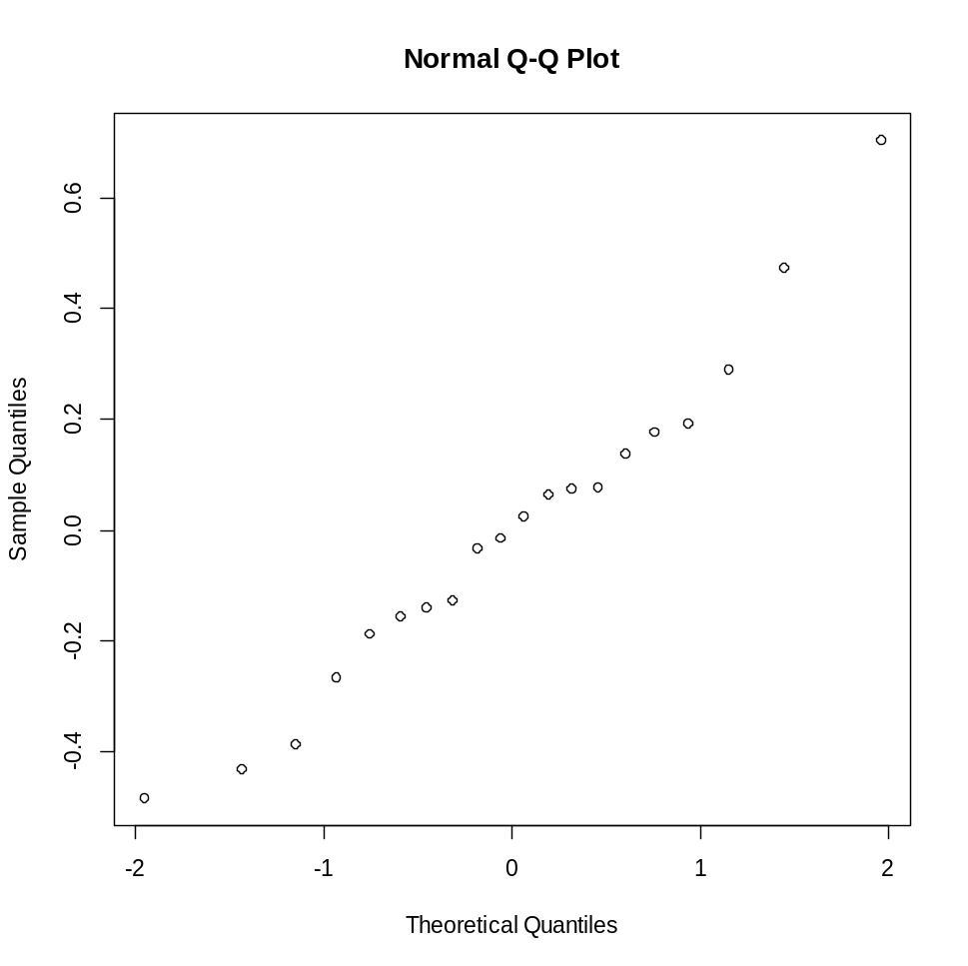
A qq-normal plot
No pattern is detected so we conclude that the random error is normal distributed.

Slide 87
Do not use only one residuals plot for model diagnostic
Another example in which the qqnormal plot indicate that the random error is normal distributed and the the plot with the residuals versus the predictor indicates on non constant variance.

Slide 88
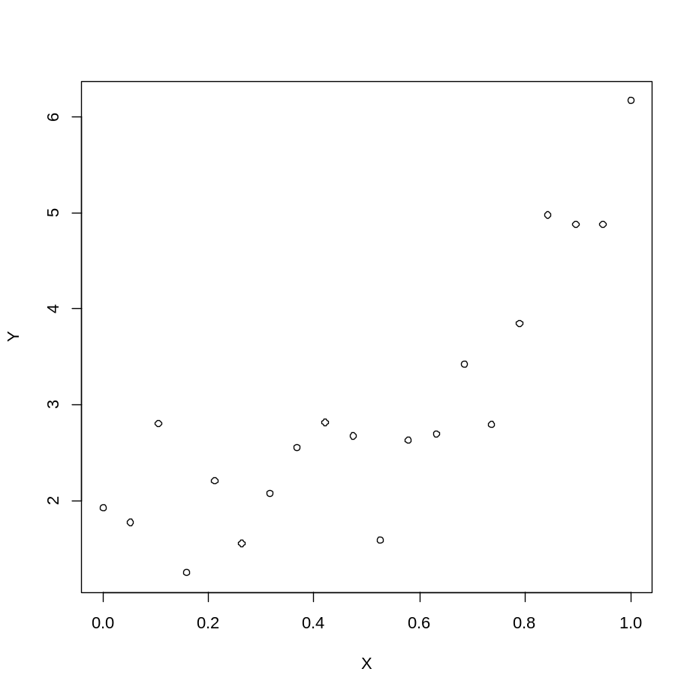
Example 3: the data
Sample size is 20.
The relatioship seems to be linear BUT NOT A STRIGHT LINE.
This means that a simple linear regression model will not be able to capture all structure of the data.
Example 3
External data: example3.txt

Slide 89
ANOVA table and parameter estimates
> aov(fit.example3)
Call:
aov(formula = fit.example3)
Terms:
x Residuals
Sum of Squares 23.63339 10.25865
Deg. of Freedom 1 18
Residual standard error: 0.7549339
Estimated effects may be unbalanced

Slide 90
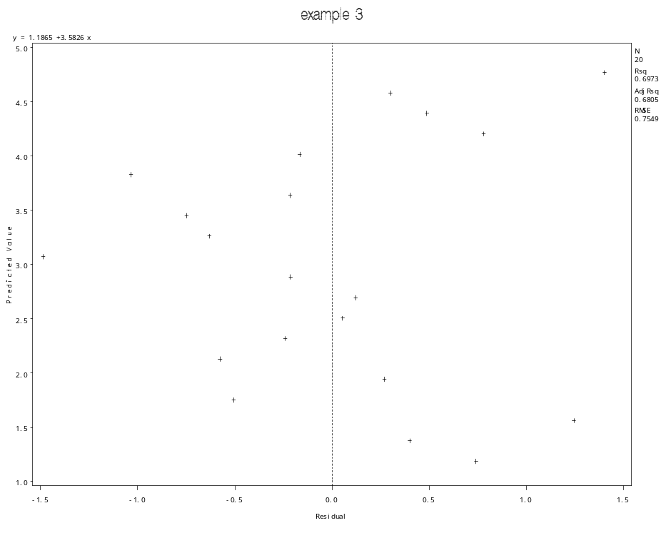
Constant variability
The residuals plot do not reavel any pattern which indicates that the variance is not constant.

Slide 91
ANOVA table and parameter estimates
> summary(fit.example3)
Call:
lm(formula = y ~ x, data = example3)
Residuals:
Min 1Q Median 3Q Max
-1.48495 -0.52386 -0.05503 0.42272 1.40292
Coefficients:
Estimate Std. Error t value Pr(>|t|)
(Intercept) 1.1865 0.3254 3.647 0.00185 **
x 3.5826 0.5563 6.440 4.64e-06 ***
---
Signif. codes: 0 ‘***’ 0.001 ‘**’ 0.01 ‘*’ 0.05 ‘.’ 0.1 ‘ ’ 1
Residual standard error: 0.7549 on 18 degrees of freedom
Multiple R-squared: 0.6973, Adjusted R-squared: 0.6805
F-statistic: 41.47 on 1 and 18 DF, p-value: 4.64e-06

Slide 92

Linearity
Pattern in the residual plot.
We observed groups with positive and negative residuals.
This means that the model does not capture all structure in the data.

Slide 93
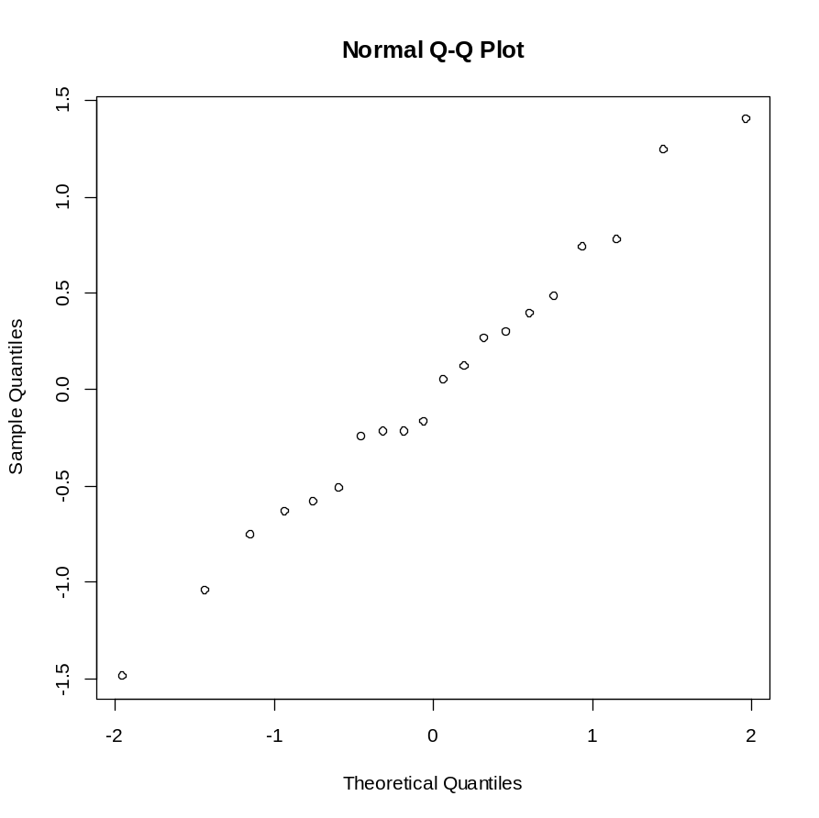
Normality
A pattern of a sgtight line in the qqnormal plot.
This indicate that the residuals follow a normal distribution.

Slide 94
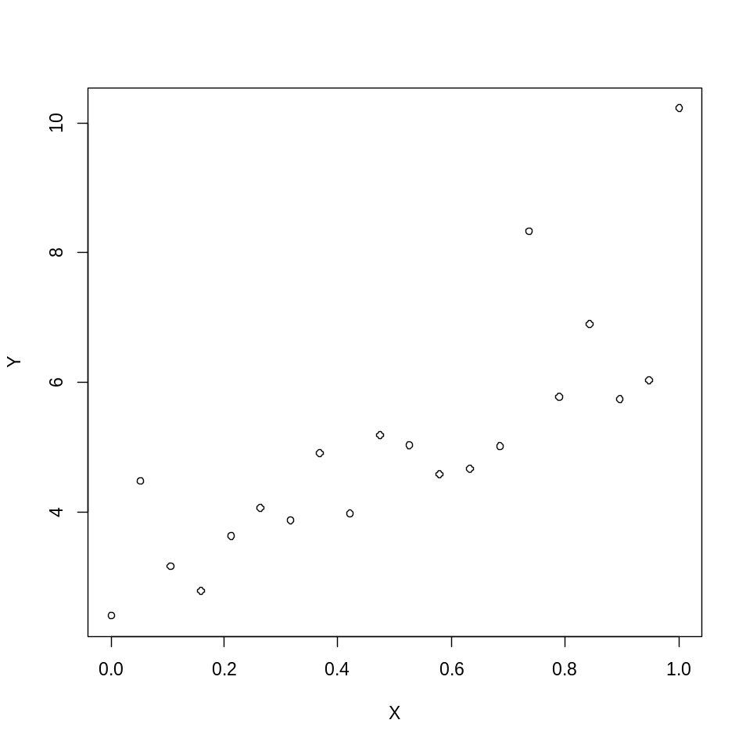
Example 4: the data
This is an example in which the three residuals plots reveal the same problem of the model which is not related to linearity and constant variability.
Example 4
External data: example4.txt

Slide 95
ANOVA table and parameter estimates
> aov(fit.example4)
Call:
aov(formula = fit.example4)
Terms:
x Residuals
Sum of Squares 42.91607 22.07751
Deg. of Freedom 1 18
Residual standard error: 1.107487
Estimated effects may be unbalanced

Slide 96
ANOVA table and parameter estimates
> summary(fit.example4)
Call:
lm(formula = y ~ x, data = example4)
Residuals:
Min 1Q Median 3Q Max
-1.2074 -0.7238 -0.1791 0.2265 2.7738
Coefficients:
Estimate Std. Error t value Pr(>|t|)
(Intercept) 2.6287 0.4773 5.507 3.14e-05 ***
x 4.8277 0.8161 5.915 1.34e-05 ***
---
Signif. codes: 0 ‘***’ 0.001 ‘**’ 0.01 ‘*’ 0.05 ‘.’ 0.1 ‘ ’ 1
Residual standard error: 1.107 on 18 degrees of freedom
Multiple R-squared: 0.6603, Adjusted R-squared: 0.6414
F-statistic: 34.99 on 1 and 18 DF, p-value: 1.341e-05

Slide 97
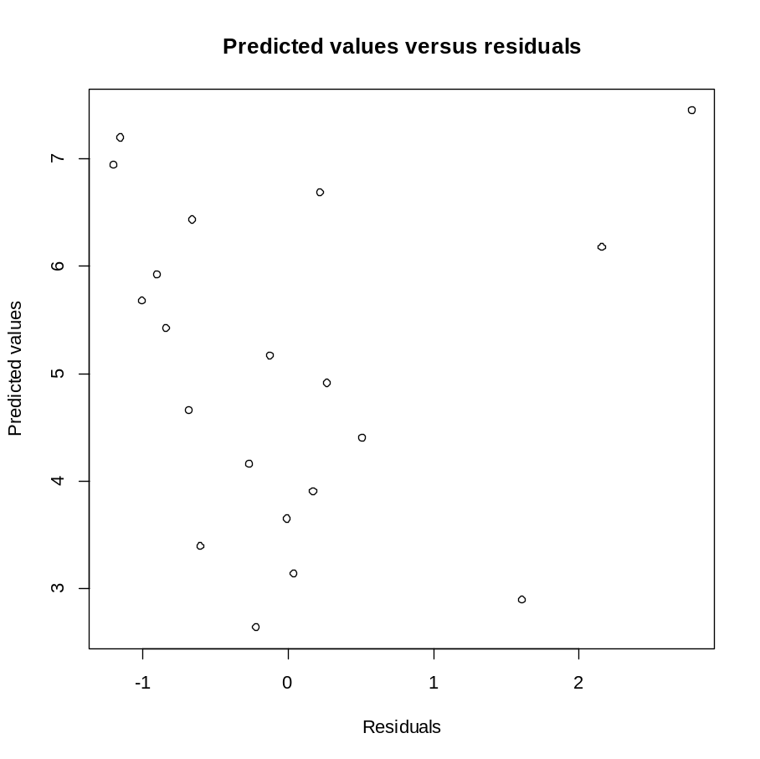
Residuals versus predicted values
Three positive outliers.

Slide 98
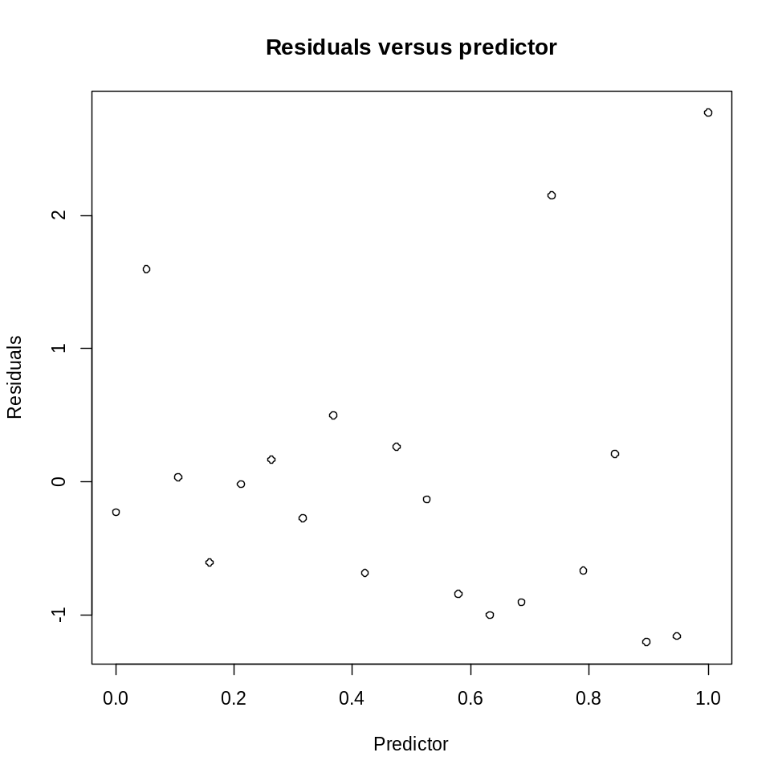
Residuals versus the predictor
There are more negative residuals than positive residuals and three positive outliers.

Slide 99
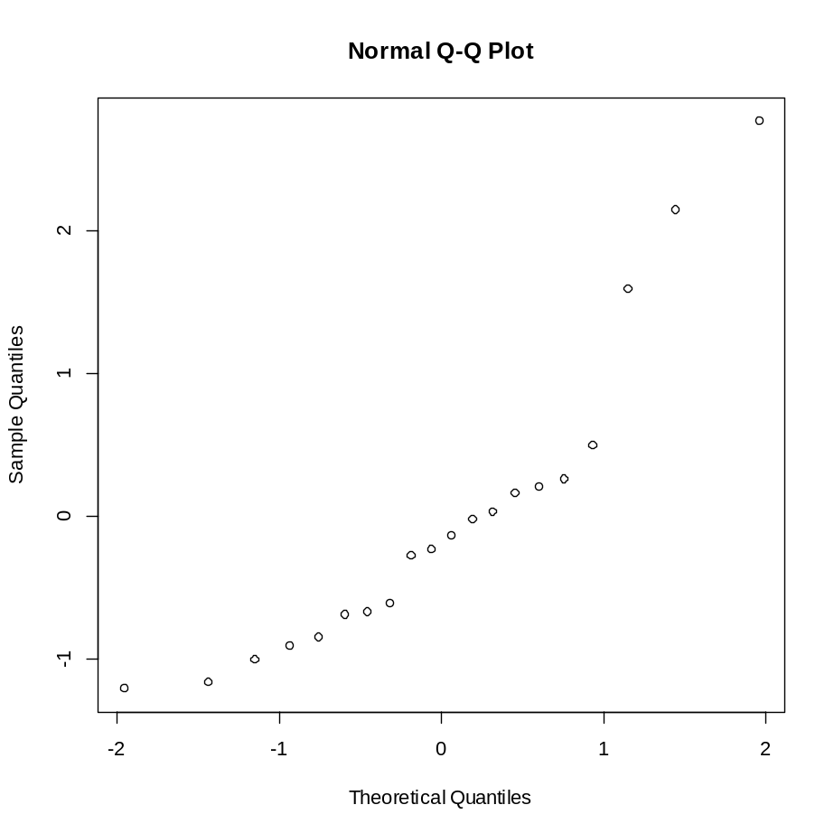
Normality
The pattern in the qqnormal plot indicates on departure from normality.
Mind the three outliers.

